Slide 1
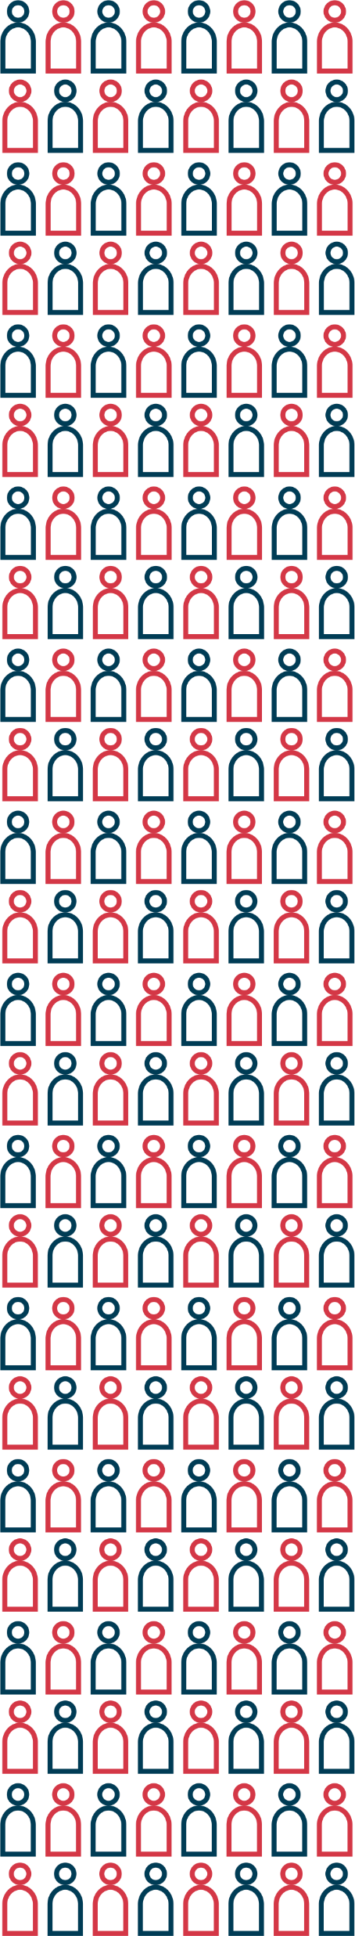
Title xxxxxxxxxxxxxxxxxxxxxxxxxxxxxxxxxxxxxxxxxxxxxxxxxxxxxxxxxxxxxxxx xxxxxxxxxxxxxxxxxxxxxxxxxxxxxxxxxxxxxxxxxxxxxxxxxxxxxxxxxxxxxxxxxxxxxx
Speaker´s name
STUDENT´S SCIENTIFIC CONFERENCE
2024
61.

Slide 2
01 INTRODUCTION
xxxxxxxxx
xxxxxxxxxx
02 XXXXXXXXXXXXX
xxxxxxxx
xxxxxxxx
03 XXXXXXXXXXXX
04 XXXXXXXXXXXX
CONTENT

Slide 3
FONT
The font used in the presentation is Gill Sans Condensed.

Slide 4
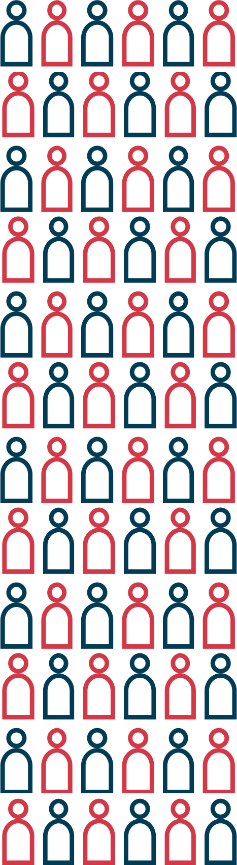
PRESENTATION WITH CONTENT
01
When the presentation is divided into numbered chapters and has a content, we put the chapter numbers in the logo placed in the upper left corner. We don´t use any other numbers or indication, such as 01a. Instead, we differentiate the chapter title, as shown on the next slide.

Slide 5

CHAPTER TITLE
01
If a chapter is divided into more sections, we put the title of the chapter in 50% transparent colour. You may copy this format and use it on other slides.
SUBHEADING

Slide 6
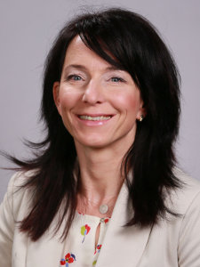
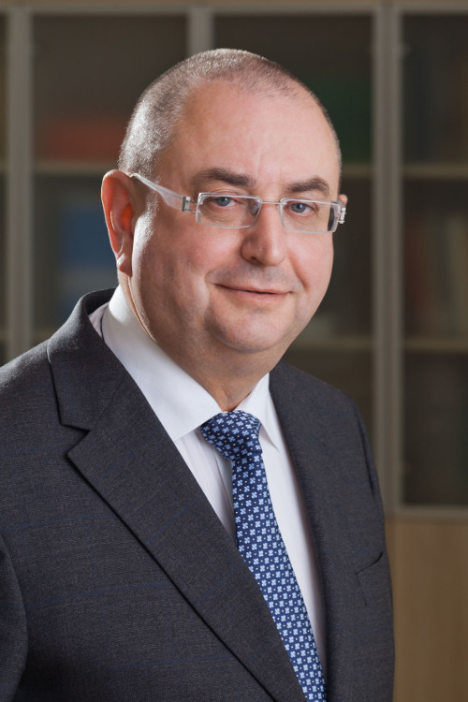
INSERTING PICTURES
Ing. Marie Klečková
Faculty secretary
02
  Pictures should be cropped and should´t overlay. They should be placed in an organized way. You may use the whole slide and only white background should be used for placing pictures.
Here you mention the source information for the images.
prof. MUDr. Fínek Jindřich Ph.D.
Dean of faculty

Slide 7
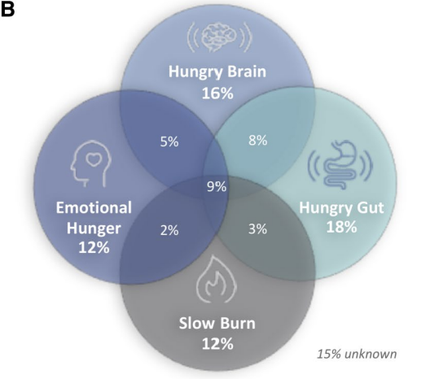
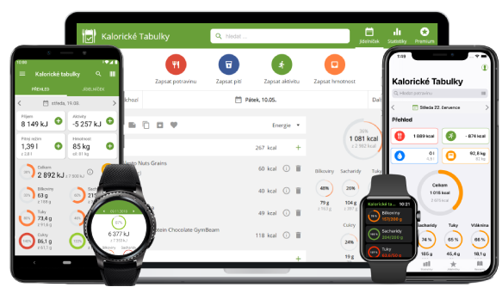
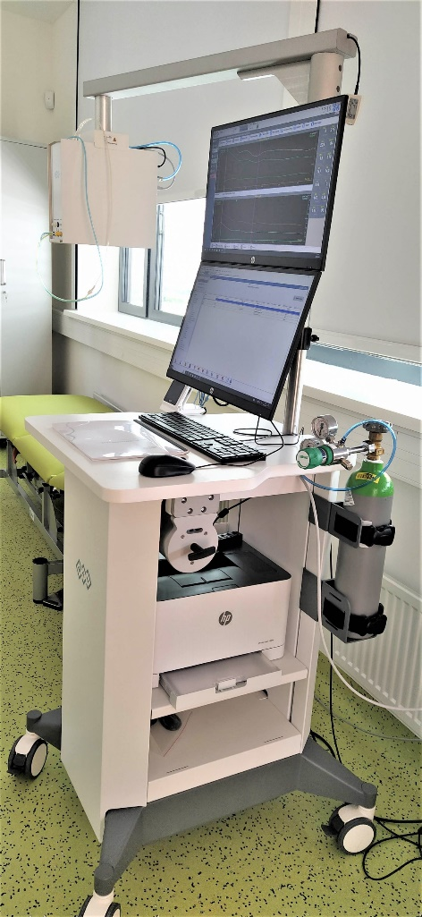
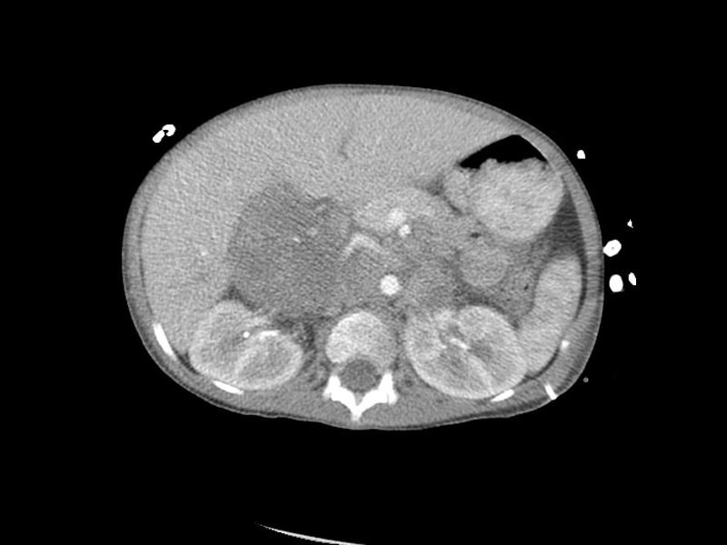
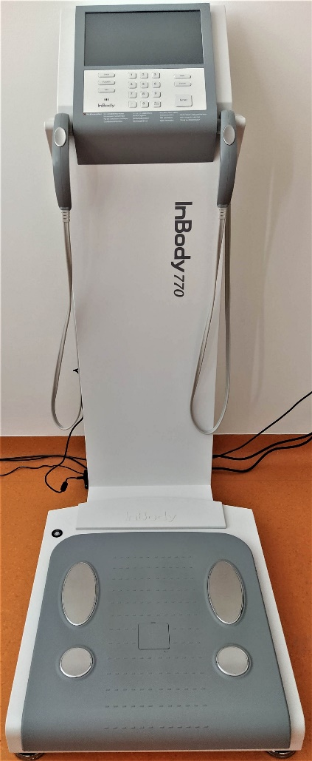
ANOTHER EXAMPLE
02
More personalised attempt

Slide 8
USING BLUE BACKGROUND
The blue background may upgrade your presentation and it makes eyes relax. At the same time, it offers more space for information, because it doesn´t have a logo.
This format should be used moderately, e.g. once in one chapter for emphasizing important or interactive content.

Slide 9
„The blue background is also suitable for placing quotes or citations.“
Advancements in our understanding of the pathophysiological basis and the interindividual variation of OB will lead to multimodal and personalised approaches to OB treatment that will result in safe, effective, and sustainable weight loss, which would also result in the decrease prevalence of obesity complication as T2D, NASH, CVD, and obesity related malignancies

Slide 10
USING
A DIAGRAM
03
BEHAVIOURAL INTERVENTIONS
psychological support
dietary management
physical activity counseling
drug
management
If you don´t insert data via a diagram tool, you may use the rectangle shape as on this slide. The text can be changed.
On this slide we used animations, which go with the diagram.
metabolic bariatric surgery
Notes:
Obesity is a chronic, progressive and relapsing disease with a rising global prevalence associated with increased morbidity and mortality and reduced quality of life.
Treatment of obesity requires a comprehensive medical approach that includes behavioural interventions, pharmacotherapy and bariatric surgery. The degree of weight loss with all approaches is highly heterogeneous, and long-term weight maintenance remains challenging.

Slide 11
TABLE ON LIGHT BACKGROUND
04
Slides with dark background offer more space. For smaller tables the light background may be used. The colours of the table are predefined, but they can be modified.

Slide 12
EXAMPLE OF A TABLE ON DARK BACKGROUND
Put the source information.
Medication name | Pharmacological class | Typical adult maintenance dose, administration | Approval | Mean placebo-subtracted BW loss from baseline %
Orlistat | Gastric & pancreatic lipase inhibitor | 120 mg three times daily oral | US, EU | 3,1
Phentermine/ topiramate ER | Sympathomimetic amine anorectic /antiepileptic | 7,5 mg/46 mg once daily,oral | US | 8,6-9,3 (15 mg/92 mg)
Bupropion ER/ naltrexon ER | Antidepressant/ opioid antagonist | 16 mg/180 mg twice daily, oral | US, EU | 4,8-5,2
Liraglutide | GLP-1 RA | 3 mg once daily, SC | US, EU | 5,4
Semaglutide | GLP-1 RA | 2,4 mg weekly, SC | US, EU | 12,4
Setmelanotide | Melanocortin agonist | 3 mg once daily, SC | US, EU | (10)
Notes:
Recent insights into the complex pathophysiology of obesity have increased our understanding of intervenable targets for pharmacotherapies to treat obesity and improve weight-related cardiometabolic complications, namely, type 2 diabetes, hyperlipidaemia and hypertension. As a result, novel potent therapies have emerged, such as semaglutide, a glucagon-like peptide-1 receptor agonist (GLP-1RA) recently approved for the treatment of obesity.

Slide 13

Final picture.
You may use any
other picture.
61.
2024
SVK
SSC

